Slide 1
The open source world & personal projects

Slide 2
Elements of open source
We’ve learned the technical parts of Git, but let’s talk about the more abstract “collaboration patterns” that you’ll see.
Issues / tickets
Forks
Stars
Merge requests / pull requests

Slide 3
Issues & Tickets
Usually the workflow for “tickets” is:
A customer or QA tester finds a bug
They make a “ticket” in a ticketing system with the importance, a short message, maybe a few other details
A set of developers continuously look at the list of tickets, and use those to work on stuff

Slide 4
Issues
Issues are just a newer word for tickets, usually in the context of github
E.g., markus’ issues: https://github.com/MarkUsProject/Markus/issues
An important java library’s issues: https://github.com/google/guava/issues

Slide 5
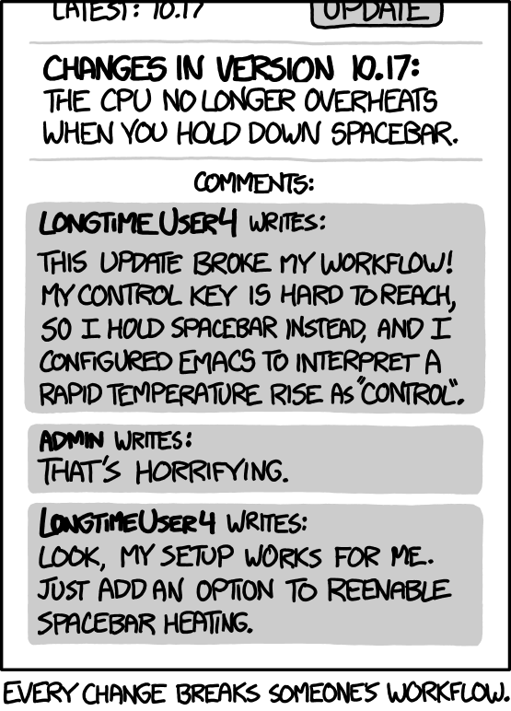
An aside: The law of infinite issues
Issues sound great in theory, but you never get anywhere if you just solve issues
For example, if you make any software that anyone uses, they will propose features and hard to find, unimportant bugs
You *must* choose to close issues as “wontfix” or you’ll never solve anything!
Treat them as suggestions & tools for finding major issues, not as a TODO list.

Slide 6
Forks
Forks are not a feature of git, they’re a feature of github.
They just copy someone else’s repository into your account.
(e.g., you might not have permission to make branches on the “real” repository, so you need somewhere to push your changes -- it makes sense for that to be on your account.)

Slide 7
Forks
Forks are *not* meant for “this project is cool! I want to keep it around”
They will just clutter your repositories pane if you use them for that purpose.
Use the “star” feature instead.

Slide 8
Forks
Another reason there might be a “fork” is if people disagree with the way an existing open source project is being maintained on a specific user’s account.
E.g., you might add “you can only use this software if you like iced cream” to the terms of using the software
People could fork your project before you did that, and maintain it themselves (bug fixes / new features / …)
An example: “OpenOffice” was open source, then bought by Oracle, so people forked it into “LibreOffice” which is what is on the teaching lab computers!

Slide 9
Merge requests / pull requests
Two names for the same thing -- the request to send a commit from your repository into another person’s repository
Note: repository is the name for a “project on github” -- it’s basically synonymous with “place you can use as a remote”
Useful because you can push/pull/… to your own copy, but not other people’s copies (they won’t give permission to strangers to touch their branches), and then send your changes for review to another account.
(usually the other account is the “official” version -- e.g., MarkusProject/Markus instead of ColinChartier/Markus) but

Slide 10
A typical fork / fix / merge workflow
Here’s a typical workflow for working in open source:
Find an issue that you think you can solve / create your own issue if you find something that’s broken
Fork the repository to your own account
Pull the repository from *your account*
Fix files / commit (with a good commit message!) / push
Make a merge request from your repository to the official repository
(optionally) delete the repository from your account

Slide 11
A typical fork / fix / merge workflow
Here’s a typical workflow for working in open source:
Find an issue that you think you can solve / create your own issue if you find something that’s broken
Fork the repository to your own account
Pull the repository from *your account*
Fix files / commit (with a good commit message!) / push
Make a merge request from your repository to the official repository
(optionally) delete the repository from your account
Let’s try it!
https://github.com/Cornices/cornice/blob/master/cornice/resource.py#L21

Slide 12
A typical fork / fix / merge workflow
Your turn!
My mini lectures are on github: https://github.com/ColinChartier/207MiniLecturesF2018
This lecture is not at that link yet.
It is at this link: http://bit.do/csc207
Let’s add it to the MiniLectures list on github!
Steps: Fork the top repository, pull it onto your computer, make a change to the file, commit that change, push it, make a pull request back to the top repository.

Slide 13
Making your own open source (personal) projects
In another life I recruited U of T students for internships.
I can tell you (in my personal experience, but this greatly varies across recruiters) what I looked for in the projects prospective interns:
A team project doing something creative is the best thing to see -- it shows you know how to collaborate & tackle “new” problems.
Next is a single-person project with reasonably thoughtful commit messages & tackles a “new problem”
Next is a single-person project that’s reasonably creative & has no commit messages (it’s just all dumped at once, you don’t know git)
Any school projects where you are given a scope & direction externally counted for next to nothing.

Slide 14
Making your own open source (personal) projects
Here are some personal projects I made that I’ve been asked about for examples:
A permission system using MySQL
It’s creative (wasn’t a school project or anything)
It shows that I cared to learn new technologies (e.g., SQL, design patterns)
It was large (10,000 lines of java)
A java decompiler
Java takes .java files and converts them to .javac files -- I tried to make something that could reverse that process.
It showed that I knew when to apply algorithmic knowledge (e.g., recursion)
It showed that I could make tools (e.g., employers asked me to work on a “debugger” for their product specifically because of this project)

Slide 15
Making your own open source (personal) projects
Most importantly:
Make something that you care about! It shouldn’t feel like a chore to do personal projects.
If you care about competitive programming, make a competitive programming portal for your old website.
If you care about education, make an interactive website that teaches people how to make proofs
If you want to improve the lives of sexual assault survivors, adapt an existing project to U of T’s needs and figure out how to deploy it as a minimal viable product.

